Slide 1
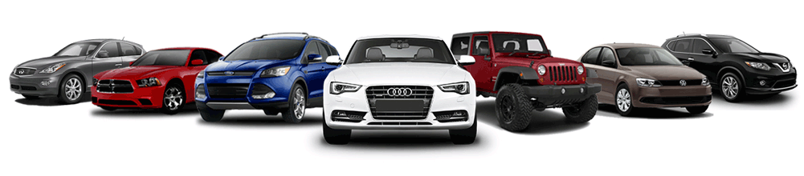
Modeling Used Cars Data
By: Peyjmon Ahmad

Slide 2

Approach
Find optimal web scraping environment
Compare Regular and Luxury Car data
Isolate features to predict outcome
Create model

Slide 3




Sources Used

Slide 4
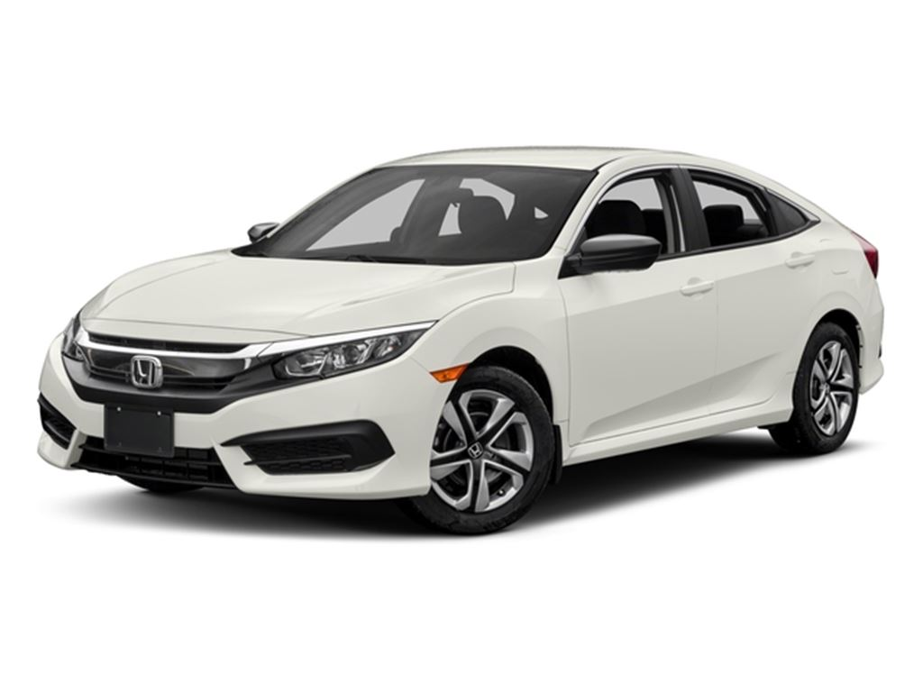
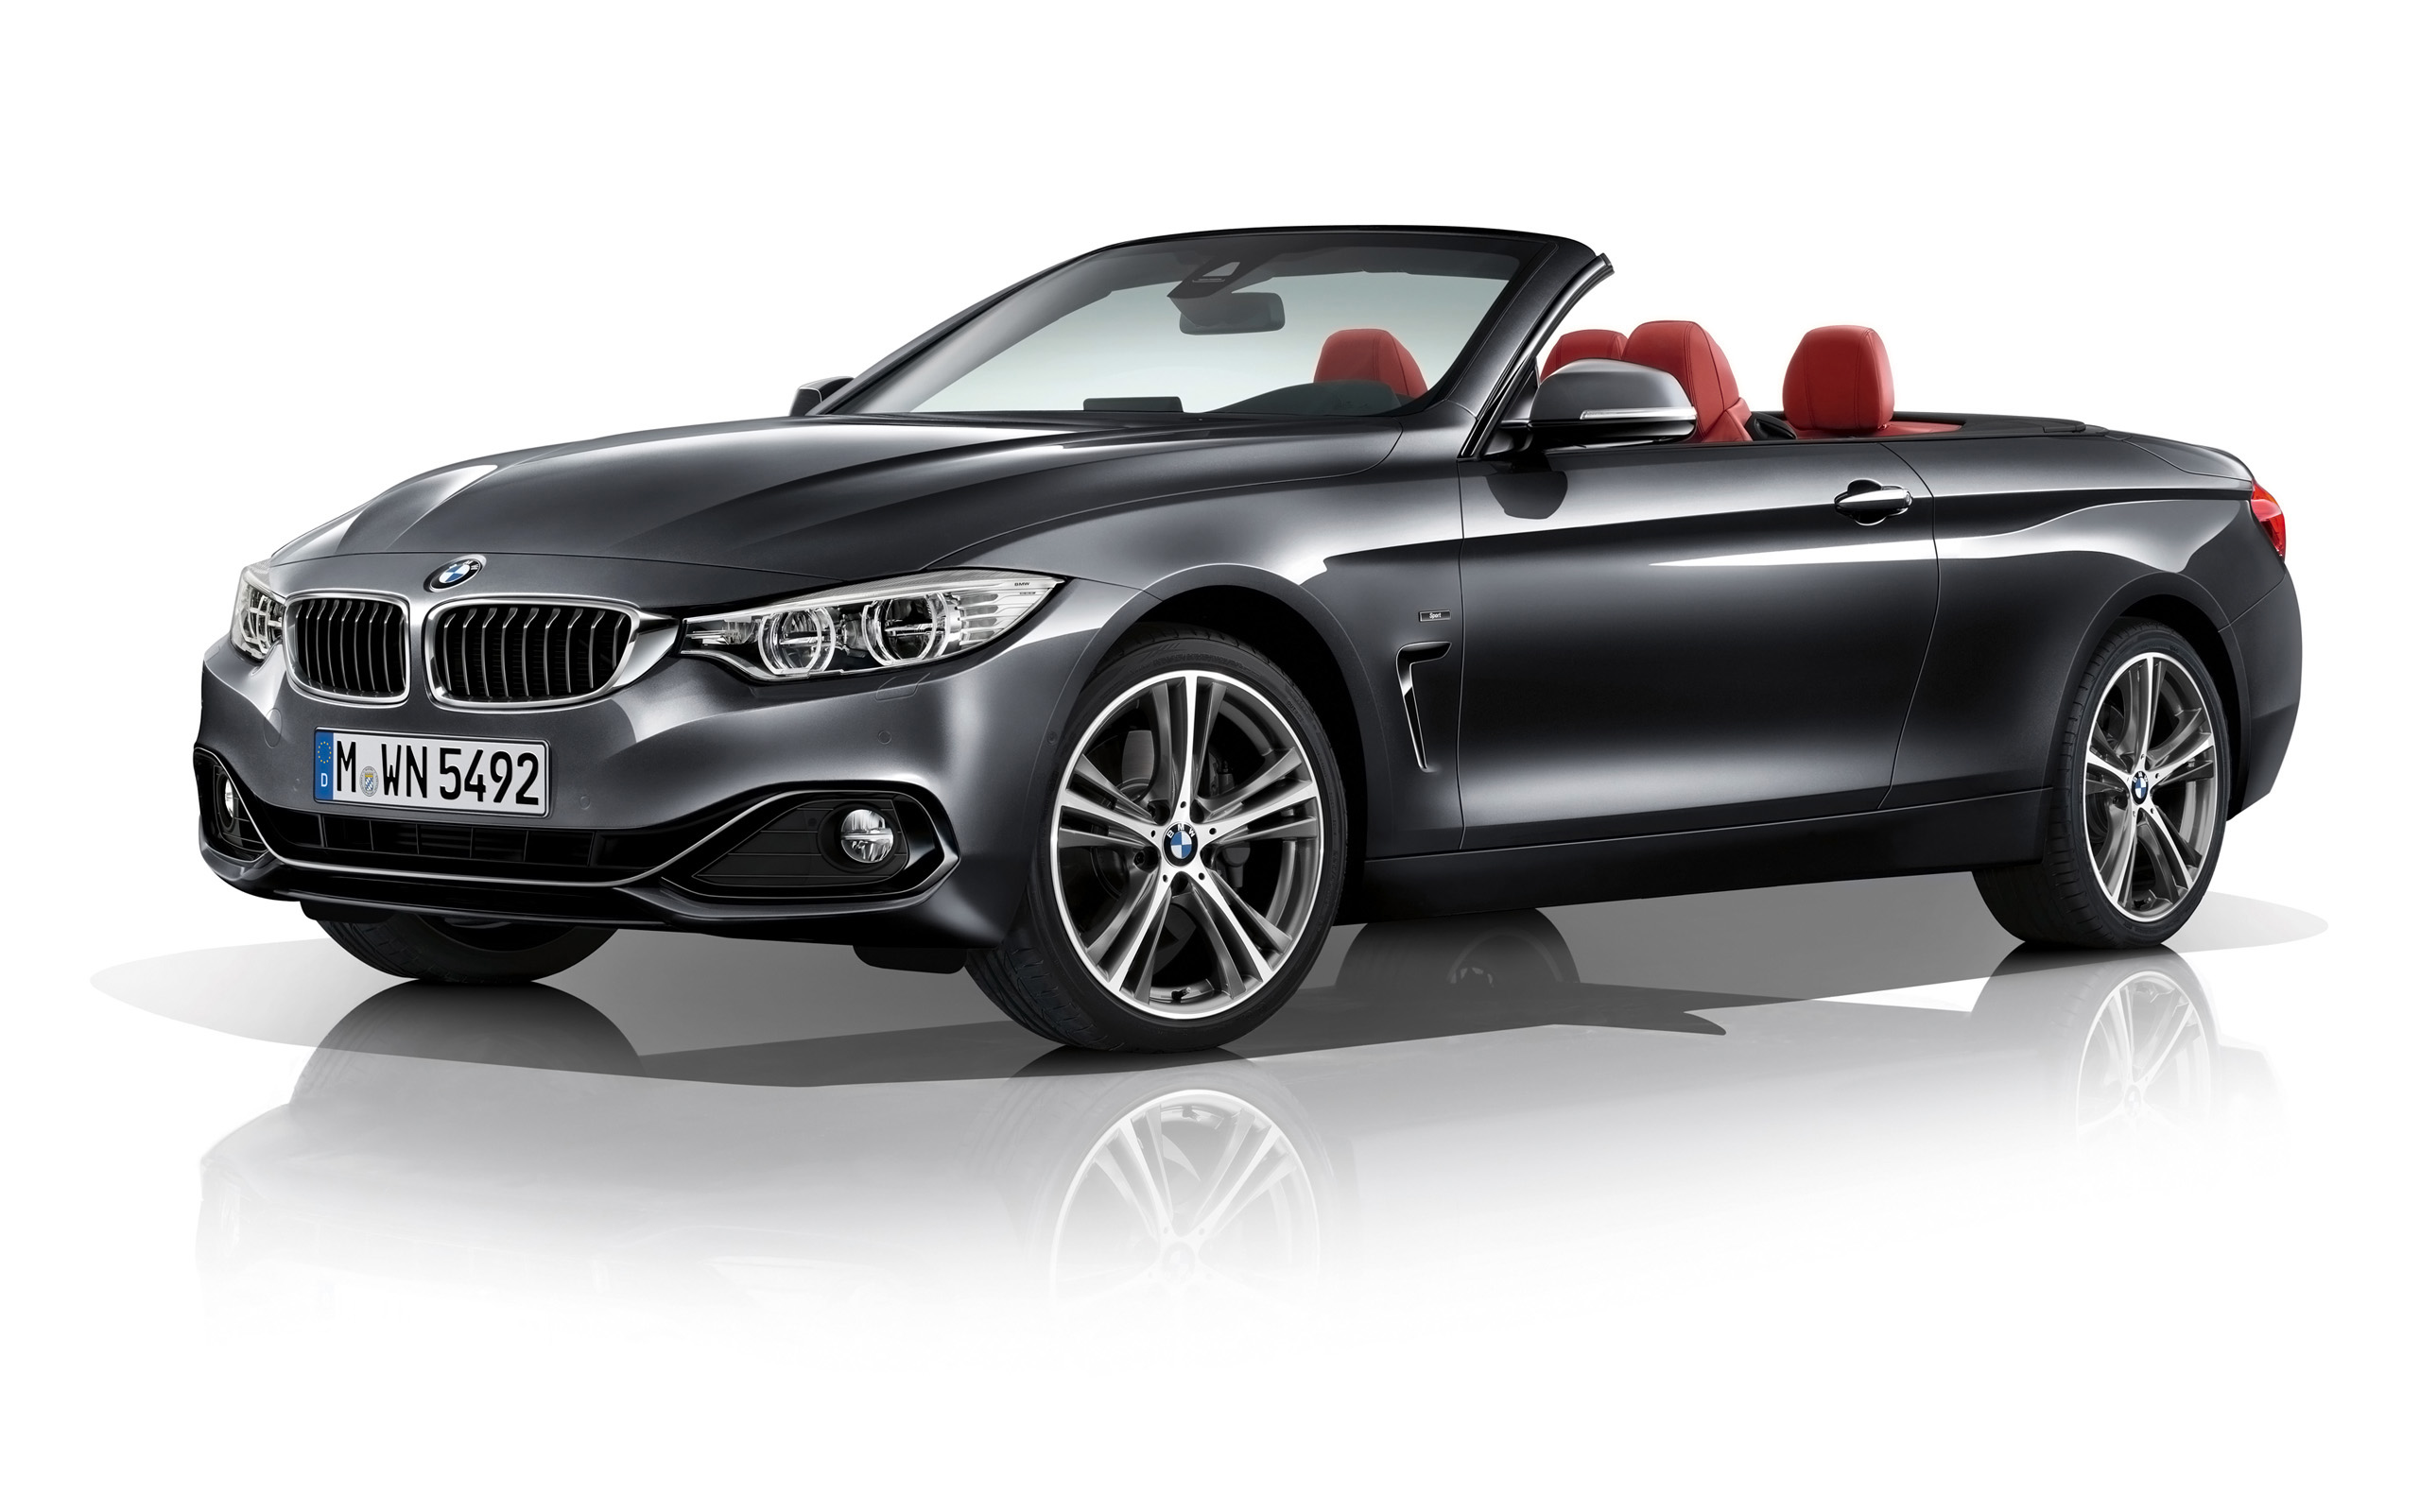
Data Breakdown
1,500 Total Cars
750 Regular & 750 Luxury
Regular
Ford, Honda, Toyota, Volkswagen, Nissan, Chevrolet, Mazda, Hyundai, Subaru, Kia
Luxury
BMW, Mercedes, Lexus, Audi, Acura, Cadillac, Porsche, Infiniti

Slide 5
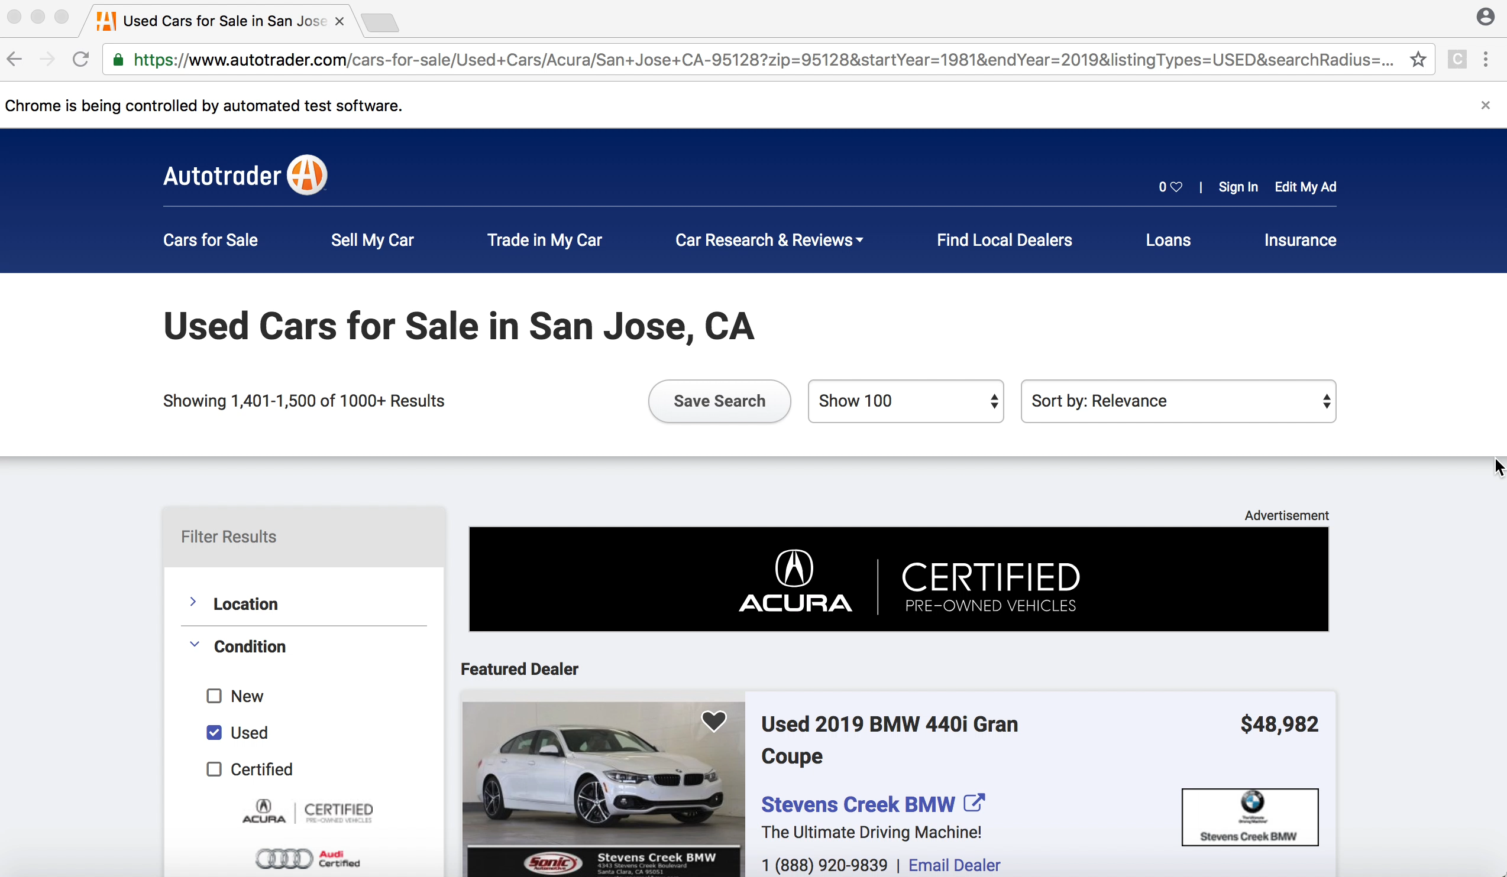

Slide 6
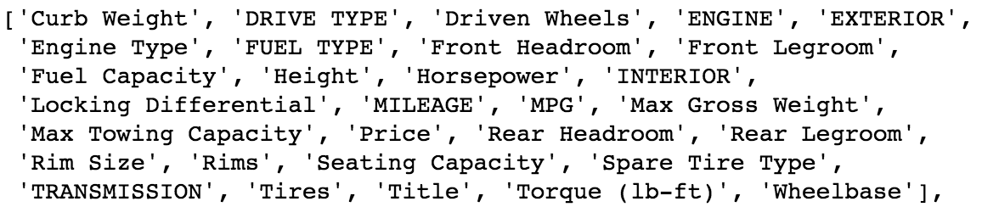
Initial Data
30 Columns
Variables kept
Engine (Cyl)
Rim Width
Mileage
Torque
Year
Variables removed due to Collinearity:
1. Engine Size (L)
2. Rim Diameter
3. MPG
4. Horsepower

Slide 7
Do Regular and Luxury cars differ?

Slide 8
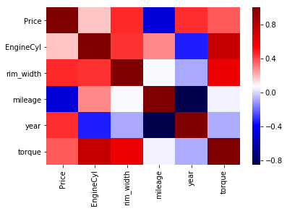
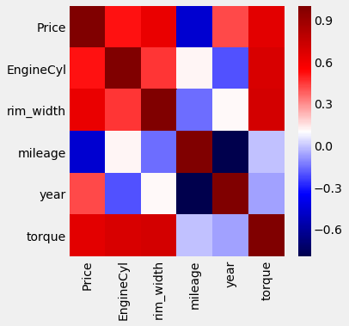
Regular Cars
Luxury Cars

Slide 9
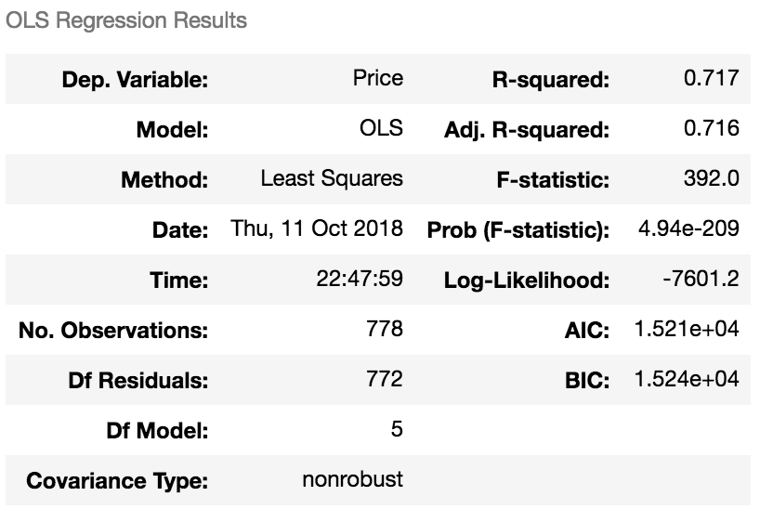
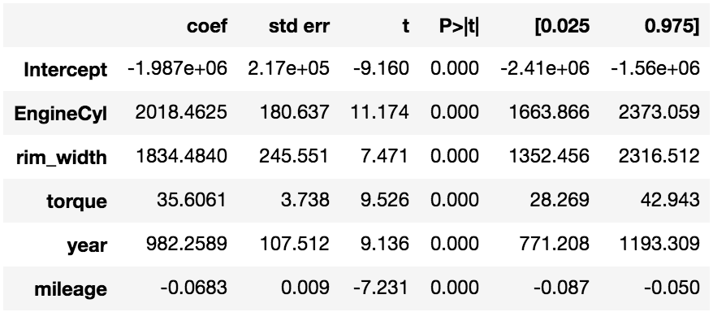
OLS Regression with Regular Cars
Target (Y) = Price
Features X(i) = Engine-Cyl, Torque, Rim Width, Mileage, Year

Slide 10
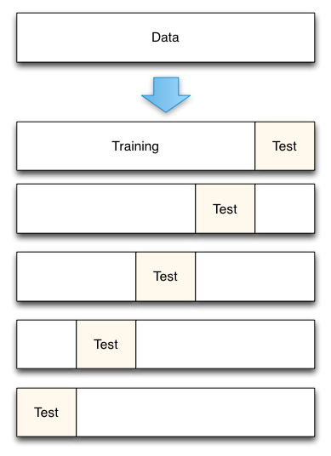
Cross Validation
Train-Test Split Done (0.20)
5 Equal Folds
Computed Cross Val Score
Mean of scores = 0.713
Notes:
Training-Test split Done. We performed cross validation in order to generalize my model, and test it on out of sample data. Each fold acted as a training set several times, as well as a test set once time, and this was performed for 5 different sections repeatedly
I found the average testing performance for these tests, and ended up with a mean score value, which was very close to my summary statistics

Slide 11
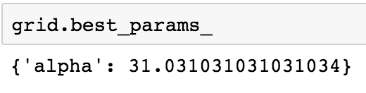
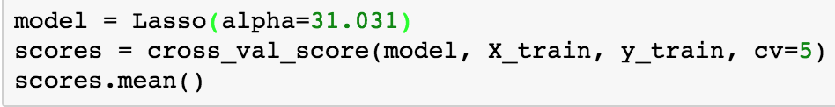
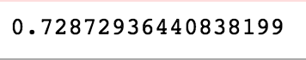
Further Results
Tested model with polynomial features (2)
Reached an Over fit of model
Used Lasso to find optimal parameter
Mean Absolute Error
About $3,409
Notes:
Chose Lasso regression instead of Ridge or Elastic Net, to find optimal parameters, and Lasso was able to add the sum of the absolute values of the coefficients to the function. This allows me to add increasingly large coefficients with minimal punishment

Slide 12
Final Thoughts
Engine-Cyl✅ Torque✅ Rim-Width✅ Year✅ Mileage✅
Continue to perfect model

Slide 13
Thanks for listening!

